Slide 1
Using Data to Find the Optimal Mix of Retail Locations and Resources

Slide 2

Introduction
Education
BS CS, Georgia Tech 2009 – Theory and Machine Learning
MS CS, Georgia Tech 2011 – Heavy Tail Network Analysis
Work
Institute of Nuclear Power Operations (2010-16)
Build, deploy, maintain a model that predicted nuclear power station performance along 13 key functional areas
North Highland (2016-)
ETL, BI, Advanced Analytics for Fortune 100 retailer

Slide 3
Data & Analytics outside academia
Case Study: Reassigning territories for district managers
Q&A

Slide 4
Working with clients
Problems are never stated formally
“Interesting” problems can be few and far between
But they can build your personal brand

Slide 5
Remapping territories – Problem description
Minimizing travel time for regional managers can reduce incurred travel costs and boost morale
Aligning districts to strategic goals can help ensure a variety of goals:
A level playing field where top talent can be evaluated evenly
Specialized focus for individual district owners
No one regional leader becomes overburdened compared to the others

Slide 6
Available data
Store Metadata – geocoding, age, size, store annual sales category, etc.
Sales Data – department, class, subclass, SKU grain data anywhere from monthly roll-ups to individual transactions
Inventory Data
Online Transactions
Current Territory

Slide 7
(abbreviated) Toolbox of techniques
Technique 1: k-means
Unsupervised Learning
Identifies a number of means around the map and builds clusters with equal variance inside them
Very much a black box-hard to specify, and requires a lot of tuning
Use if: You want to explore your data, equal size isn’t as important
Technique 2: Integer programming
Can specify exactly what you want, but rules are rigid
Computationally impossible for large datasets—constraints have to be relaxed
Use if: You have little data
Technique 3: Network construction
Randomized (or can be non-random) algorithm to build out a network ‘greedily’
Easy to specify and tune parameters as you go
Use if: Iteration is OK, exact solutions aren’t required

Slide 8
Pulling it together
SQL
Python
Pandas
High performance data management/manipulation, SQL-like interface
Numpy
N-dimensional arrays, math libraries
Scikit-learn
Huge number of supervised and unsupervised ML algorithms prewritten
Networkx
Network/Graph analysis library
Brute force

Slide 9
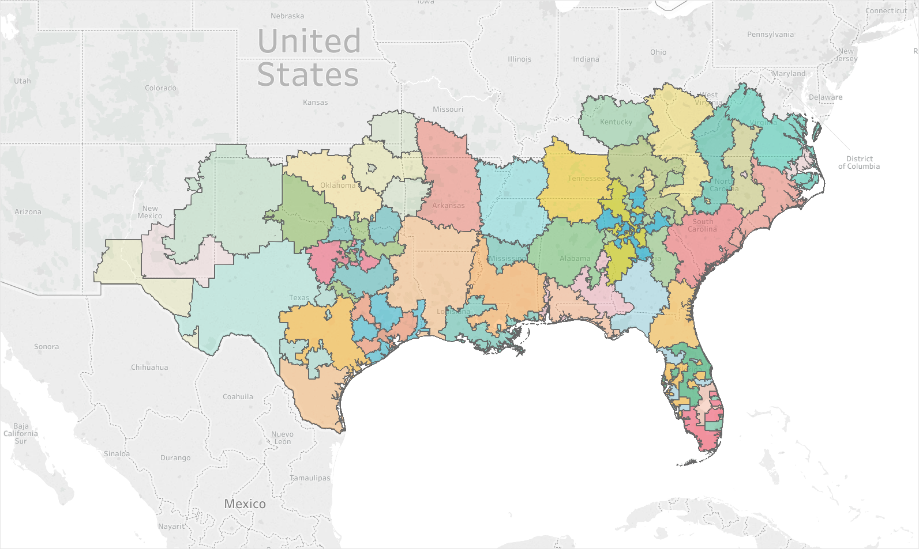
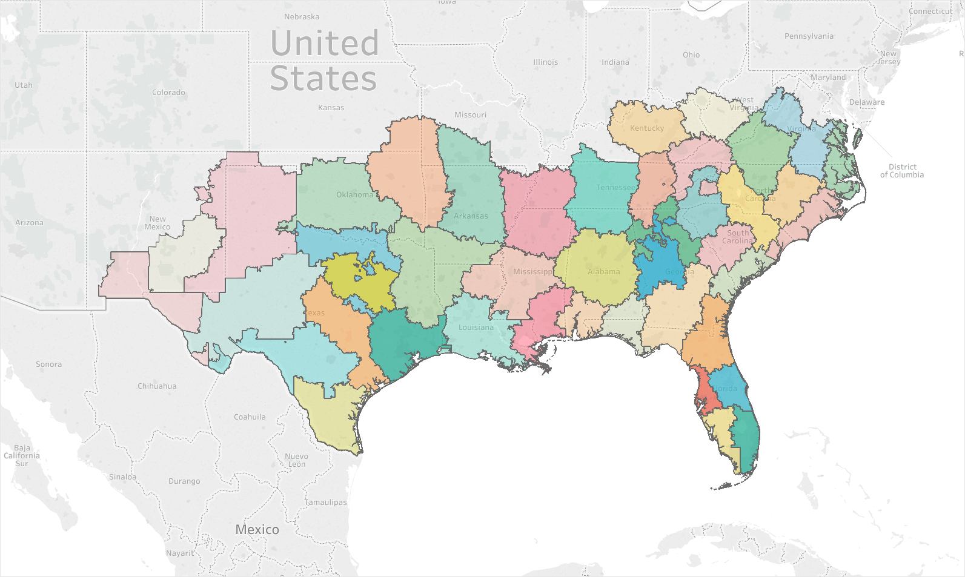
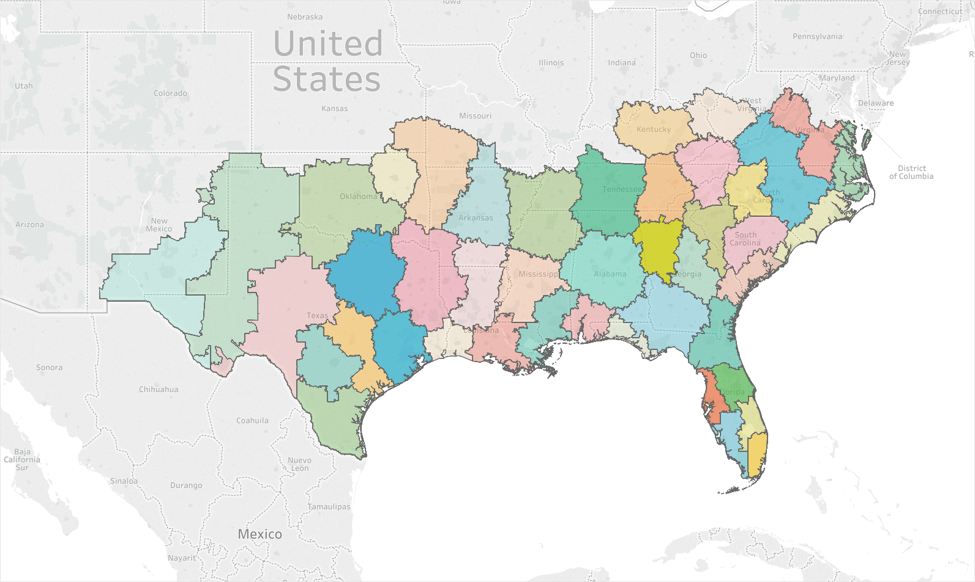
Low Spatial Weighting
Medium Spatial Weighting
High Spatial Weighting

Slide 10
networkx
https://networkx.github.io/
Graph data structure with huge library of built-ins
Graph Operations
Edge/Node maintenance, weighting, node attributes, etc.
Graph Algorithms
Connectivity, Neighborhoods, k-core, max-flow, matching, bipartite, approximation algorithms, and on and on…
Linear algebra library that takes graph objects
Eigenvalue spectrums, laplacians, PageRank
Generators
Random graph generators (e.g. random normal, Erdős–Rényi, power law)
Canonical graphs (Karate club, Florentine families graph)
Visualization Tools

Slide 11
Greedy algorithm overview
Load data
Using networkx, build an approximately-planar graph based on district mean locations
Find the norm of the district centers, pick n-closest
Set parameters for “optimizer”
Loop:
Pick manager with lowest score, assign them a random district that’s a neighbor as long as constraints are met
If that manager has no districts, pick a random district to add.
Simulated annealing—jostle where districts are in an attempt to avoid local minima, cooling over time
Once all districts are assigned, score districts and reshuffle them to minimize variance

Slide 12
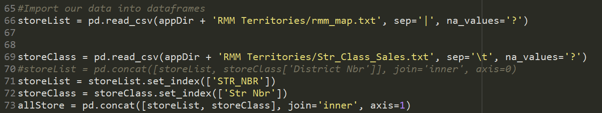
Load data

Slide 13
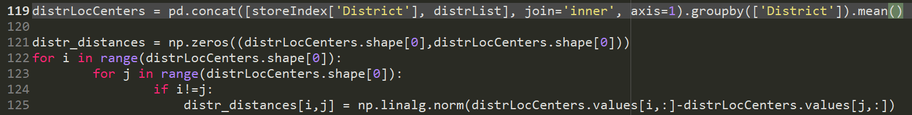
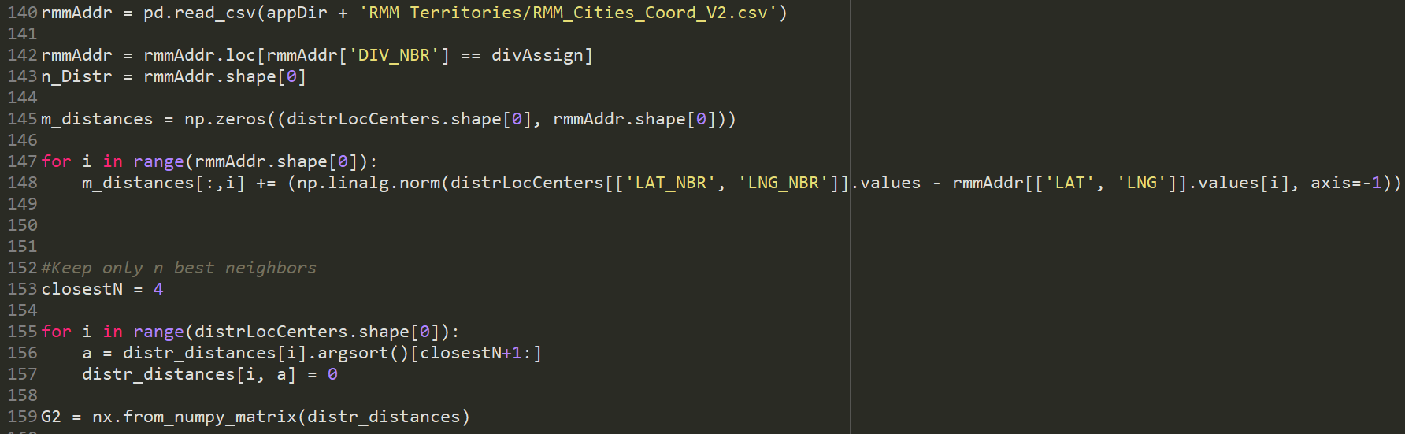
Build graph

Slide 14
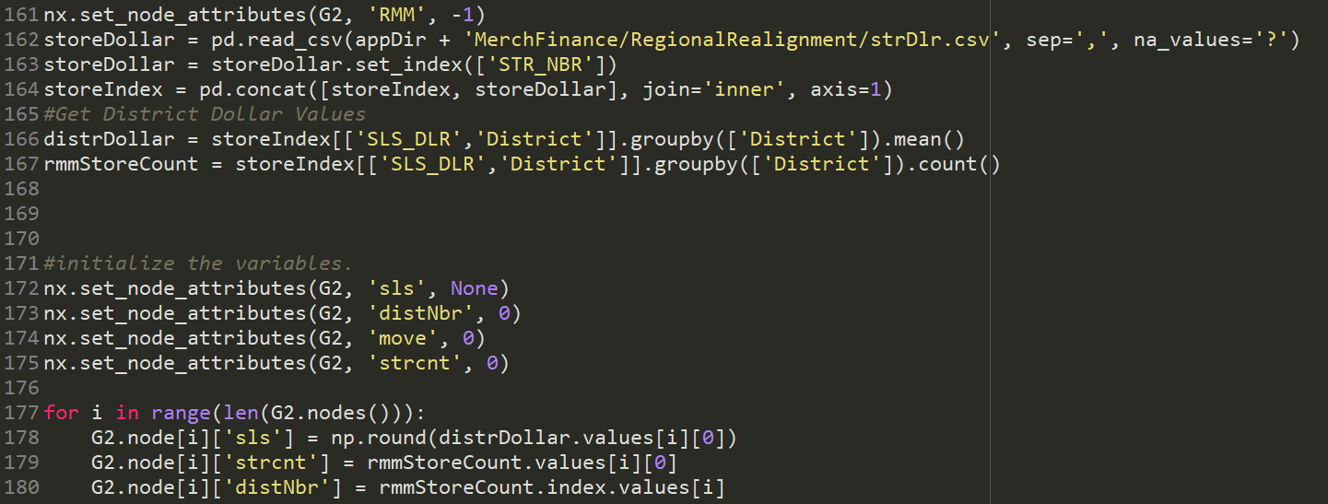
Parameters and controls

Slide 15
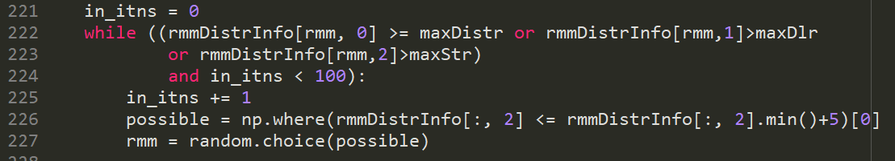
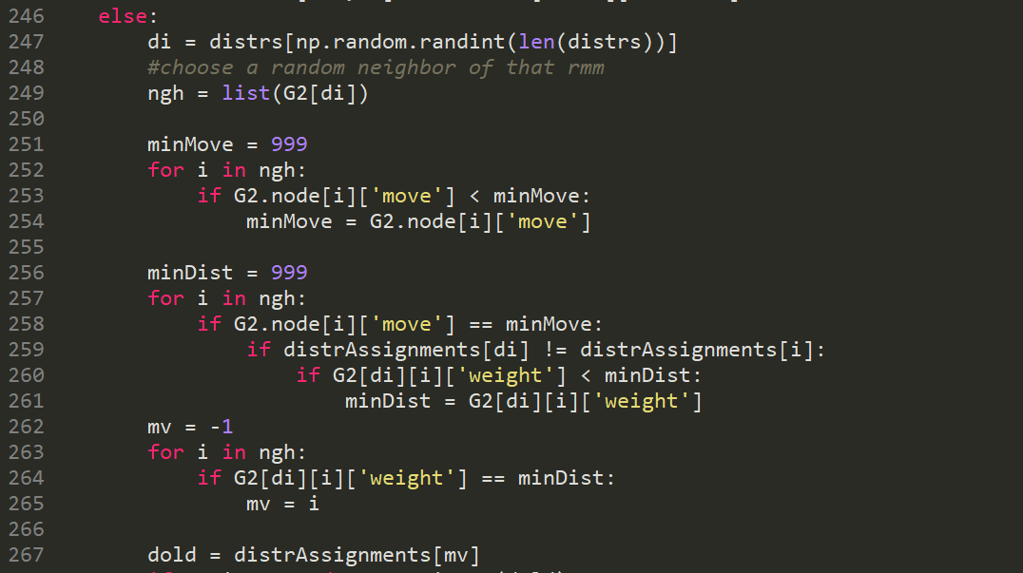
Iterate and be greedy
Pick a random manager from the ones that have approximately the lowest score
Get a list of possible districts they could have, and randomly pick one of those
Verify all the constraints (lots of IFs) are met
Perform some simulated annealing along the way—some random chance to jostle districts from one manager to another adjacent manager occasionally to avoid local minima
If all districts are assigned, still grab a local district if it improves your score more than it decreases your neighbor’s score

Slide 16
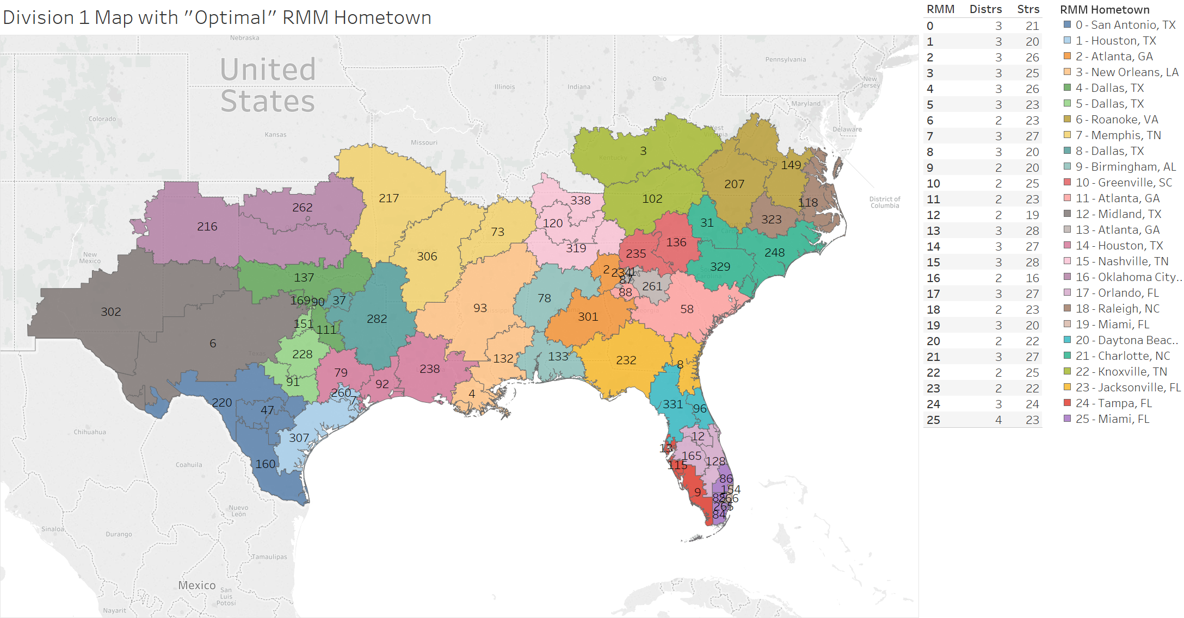
results

Slide 17
Why do it this way?
Explainable
Client has minimal experience and trust of advanced analytics, a simple algorithm makes it easier to get buy-in
Repeatable, with little variation
Similar but not identical results allow fine-tuning / re-running to smooth out client concerns
Very easy to tweak in live sessions
Simple code, simple algorithms mean you can modify on-the-fly in response to questions
In this case, all solutions are approximations
There’s no right answer

Slide 18








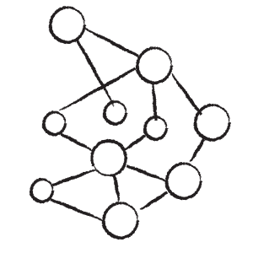

Some other projects
Are there natural clusters and needs of customers/employees?
Advanced Analytics Toolkit
Based on forecasted vs. actual sales, what stores are under-performing? Where should the next store be located?
Which customers/employees are likely to churn? Why?
Predictive/Explanatory modeling
Behavioral segmentation
Survey segmentation and projection
Forecasting
Pricing analytics
Design of Experiments (A/B and MVT)
Text/VOC analytics
Social influence propensity
Among elderly population, who is likely to need assisted living?
Key Business Questions
Which customers are likely to click/convert
Which patients are likely to be readmitted?
Why?
How do we create robust tests of content customers are most likely to respond to?
Can we use predictive maintenance to minimize production impacts?
Who are most likely social influencers?
What is the next best action/offer for each customer?

Slide 19
Charlie morn
Sr. Data Analyst
North Highland
charlie.morn@northhighland.com

Slide 20
QUICK OIL CHANGE CHAIN
Transactions
(Dates/mileage)
PROBLEM
Our client has a large base of customers that are “oil-only” and have never used them for mechanical services (e.g., belts, brakes, hoses)
SOLUTION
Develop a predictive model used to target customers most likely to convert so they can receive a differentiated experience on their next visit.
Perform deep data-mining of prevailing customer behaviors to identify ones that tend to lead to conversion and just as important, ones that might turn off customers (e.g., “over-selling”)
A sound byte from the modeling process is that air filter replacement recommendations tend to turn customers off and reduce their chance of mechanical conversion by 25%.
RESULTS
Paid back initial investment at two month mark (based on net EBIT)
At three months (mid-October 2016), converted 1,377 customers for a total of $350k net NEW mechanical revenue.
Acxiom
(demos/hobbies
/census)
Converters /
Non converters
Vehicle(s)
(Year/Make/Model)
Store
distance
Invoice
details
Coupon
behaviors
Created 350+ 1st party variables
Target these customers with aggressive conversion offer
Theory matches reality
Decile 1 – Most likely to convert >> highest next visit conversion (9.4%)
Decile 10 – Least likely to convert >> lowest next visit conversion (2.1%)

